Slide 1
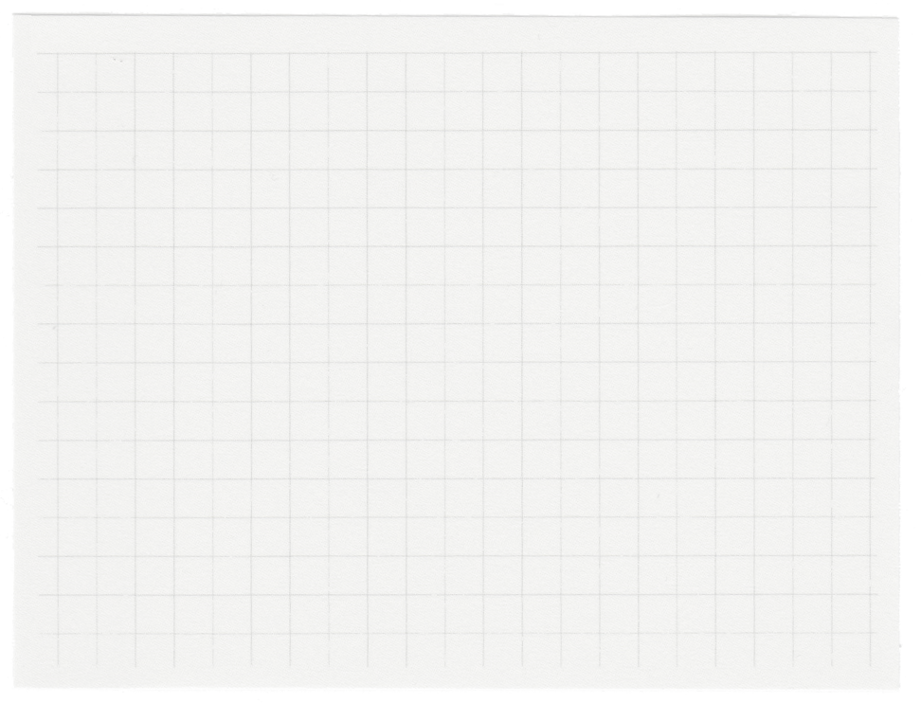















Alzheimer’s disease detection using deep learning
Early detection using MLP

Slide 2






Achyuth
Krishna
Tracita
Sharanya
Kavya
Akhil

Slide 3

Alzheimer's Disease Impact:
A progressive neurodegenerative disorder causing memory loss, cognitive decline, affecting millions globally.
Problem Statement
01.
Current Diagnostic Challenges: Early detection is limited by invasive, costly methods requiring specialized expertise, leading to undiagnosed or misdiagnosed cases.
02.
Develop an accessible MLP-based machine learning tool to analyze patient data for efficient early diagnosis.
Goal and Impact: Improve early detection and treatment, enhancing patient quality of life while reducing societal and healthcare burdens.
03.

Slide 4

Introduction
Challenges in Early Detection:
Current diagnostic methods are invasive, costly, and require specialized expertise.
Many cases go undiagnosed or are misdiagnosed, leading to delayed intervention.
Project Goal:
Develop an accessible and efficient tool using a Multilayer Perceptron (MLP) model.
Leverage machine learning to analyze a variety of patient data for early diagnosis.
Provide an accurate diagnosis tool to aid in early detection and improve treatment options.
Impact:
Improved early diagnosis will enhance patient care and management.
Reduce the societal and healthcare burden associated with late-stage Alzheimer's disease.

Slide 5

Background
Alzheimer’s Disease Background:
Alzheimer’s disease is the leading cause of dementia, marked by progressive memory loss and cognitive decline, predominantly affecting older adults.
AI has shown promise in advancing diagnosis, but reliance on pre-trained models and APIs limits flexibility, scalability, and data privacy.
Diagnostic Challenges:
Traditional methods include clinical assessments, neuroimaging, and biomarkers.
Limitations: Costly, invasive (e.g., lumbar puncture for cerebrospinal fluid), and time-consuming.

Slide 6

01.
Designed for Alzheimer's research, predictive modeling, and statistical analysis, focusing on early diagnosis using non-invasive and multi-dimensional data.
Data overview and EDA
Demographics: Age, gender, ethnicity, education level.
Lifestyle & Medical Factors: Smoking, physical activity, cardiovascular history, and more.
Cognitive and Clinical Assessments: MMSE, Functional Assessment, Activities of Daily Living (ADL).
02.
Alzheimer's Disease Dataset from Kaggle, consisting of 2,234 rows and 33 columns, covering data from 2,149 patients (IDs: 4751–6900).
Numerical Features: Min-Max Scaling and Standard Scaler (Z-Score Normalization) for consistent feature ranges.
Categorical Features: One-Hot Encoding to enable model interpretation of non-numerical data.
03.

Slide 7
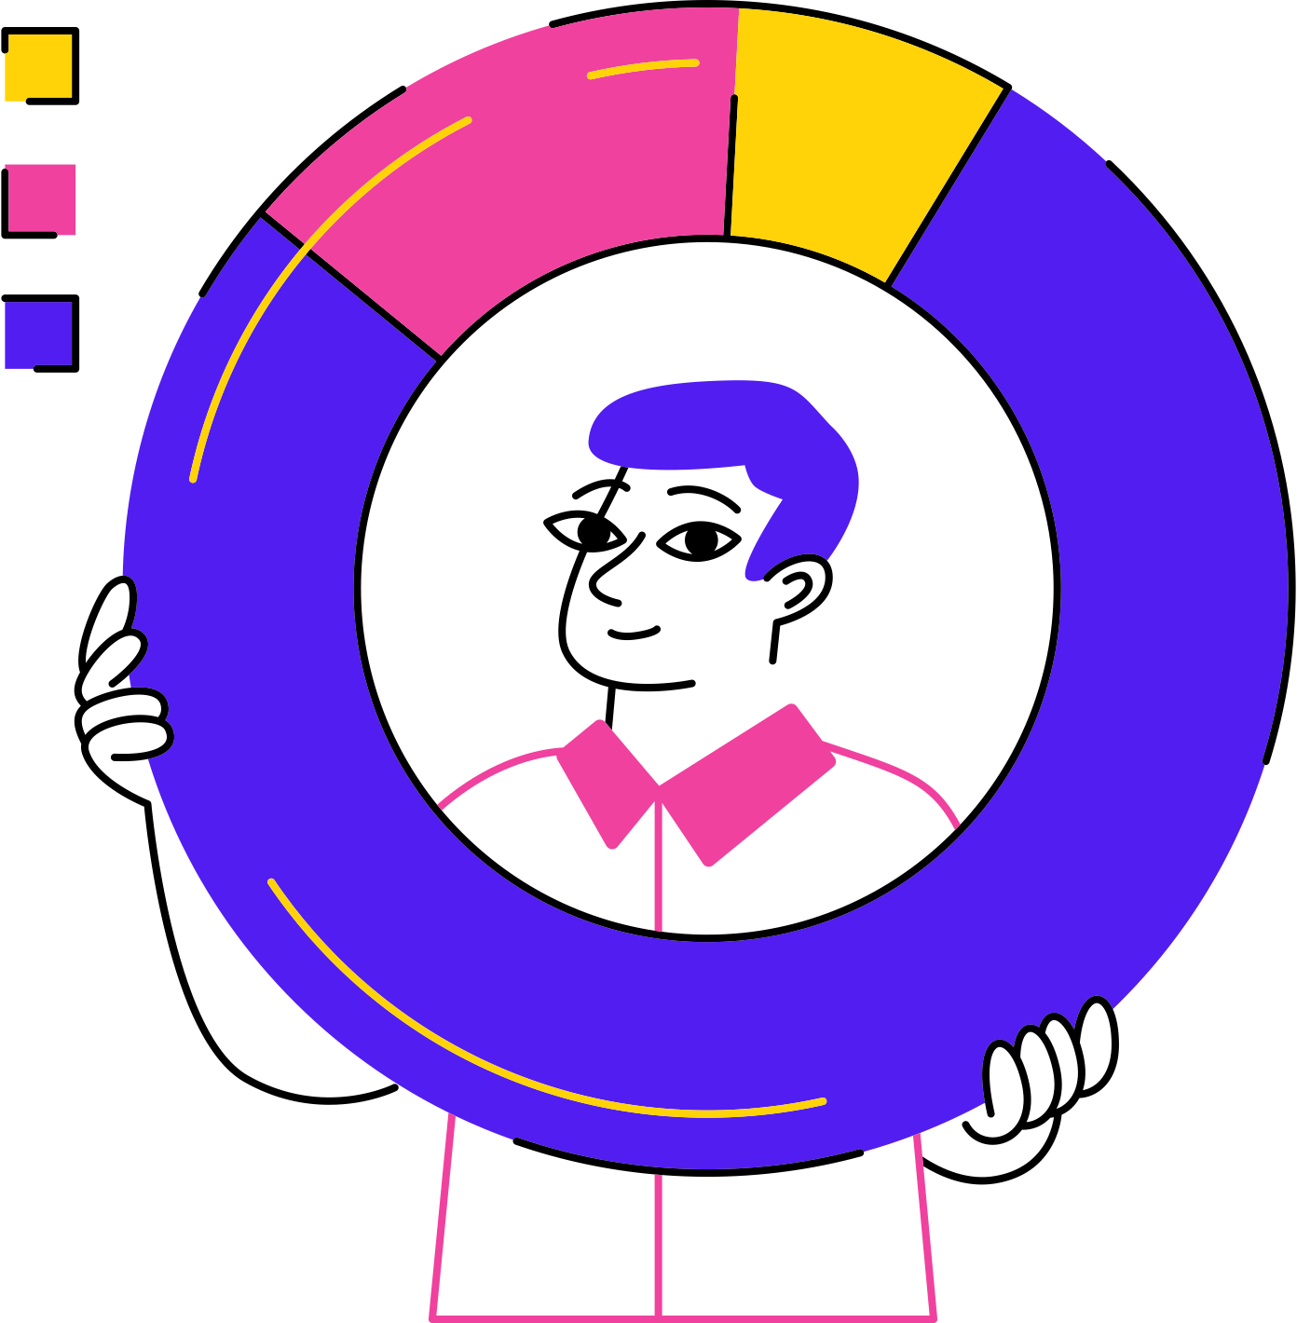
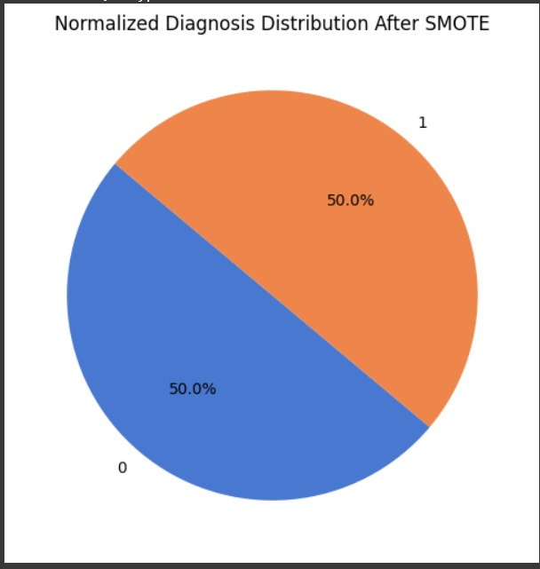
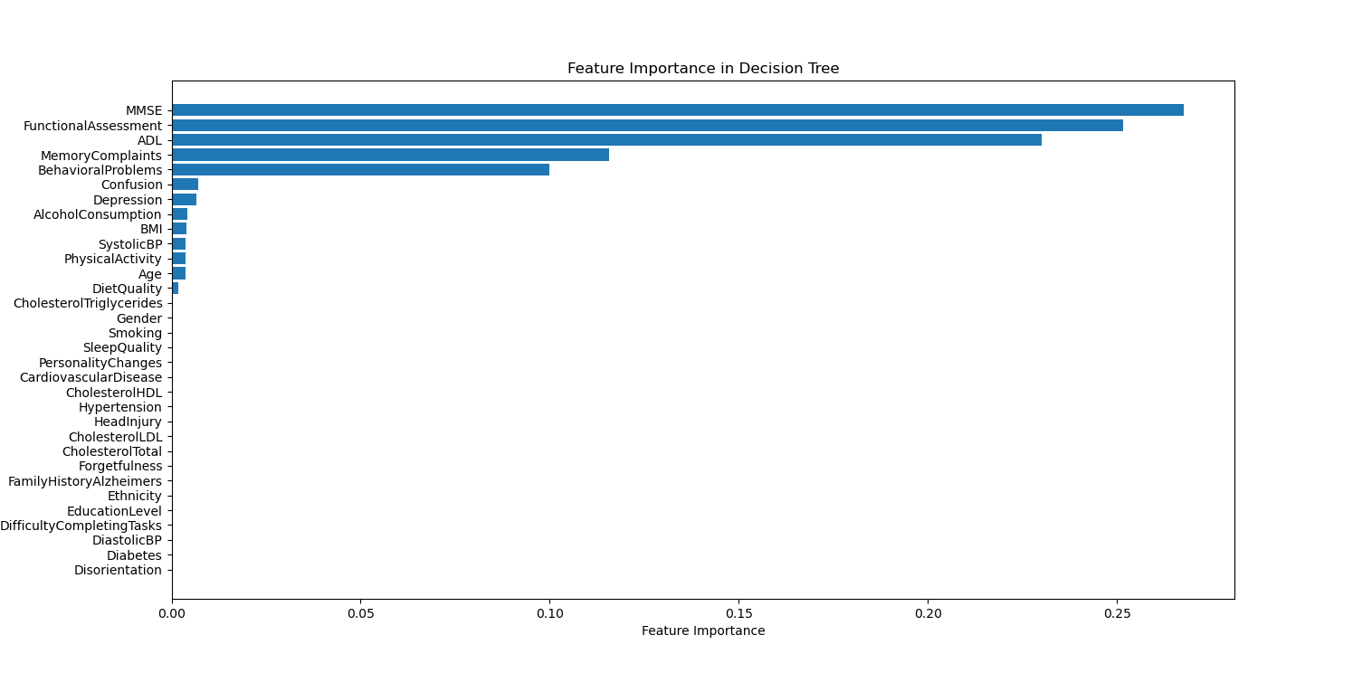
This heatmap highlights the correlation of key features such as Memory Complaints, Behavioral Problems, and ADL with Alzheimer’s diagnosis. Strong associations emphasize their importance in early prediction models.
The balanced distribution achieved through SMOTE ensures equal representation of Alzheimer’s and non-Alzheimer’s cases, enhancing the model's fairness and performance in predicting diagnosis.

Slide 8


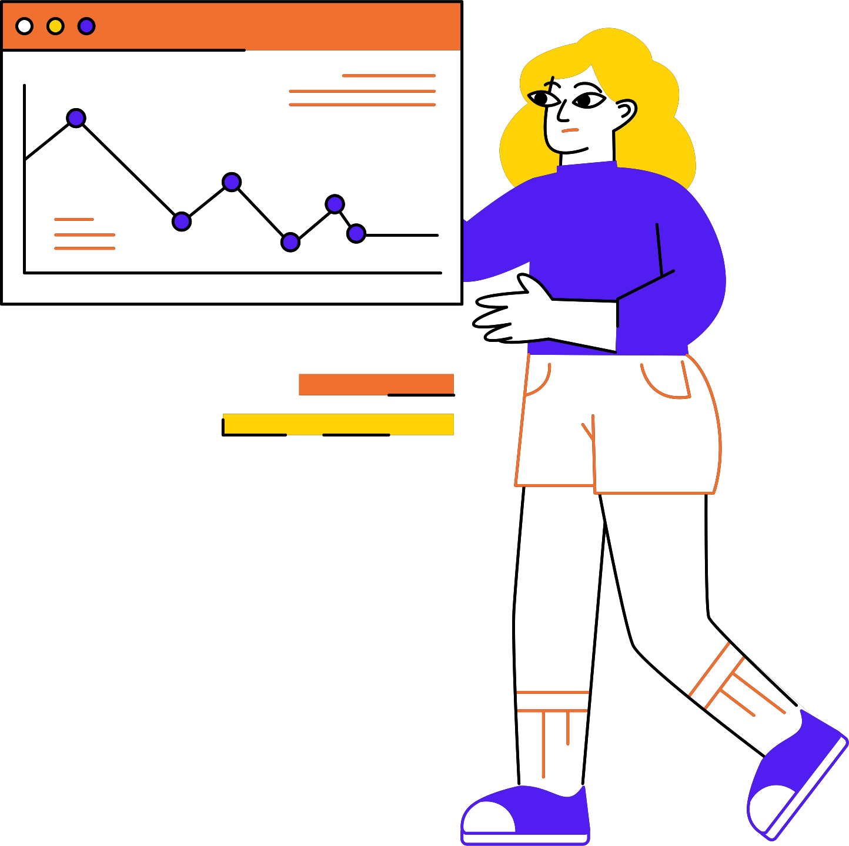





Methodology
Data
Preprocessing
Model Design
Model
Compilation
Training
Evaluation
Explainability
Deployment

Slide 9

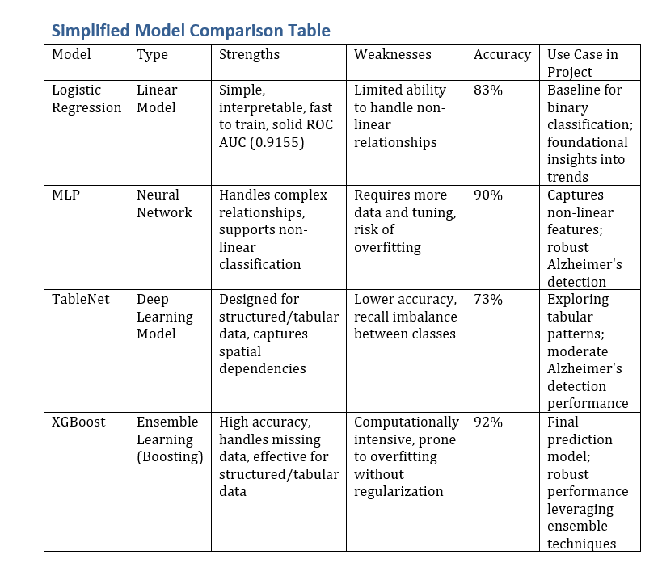

Result and Analysis

Slide 10


Class Imbalance: Fewer Alzheimer’s cases compared to non-Alzheimer’s, making it challenging for the model to learn equally from both classes.
01.
Challenges
Feature Selection: Identifying the most impactful features from the dataset to ensure better model accuracy and interpretability.
02.
Model Generalization: Ensuring the model performs well on new and diverse data, not just the training dataset.
03.

Slide 11


References
Dataset:
•https://www.kaggle.com/datasets/rabieelkharoua/alzheimers-disease-dataset
Using GANs and GNNs for Alzheimer’s Diagnosis
•https://www.sciencedirect.com/science/article/pii/S0893608023006020
Neuroimaging and Machine Learning for Alzheimer’s Prediction
•https://www.nature.com/articles/s41598-018-37769-z
Attention-Based Neural Networks for Alzheimer’s Classification
•https://ieeexplore.ieee.org/abstract/document/9074248
Public Health Data Integration in Alzheimer’s Prediction
•https://www.frontiersin.org/journals/public-health/articles/10.3389/fpubh.2022.853294/full

Slide 12



Thank you!

